Slide 1
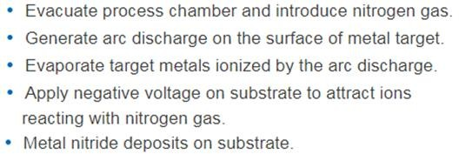
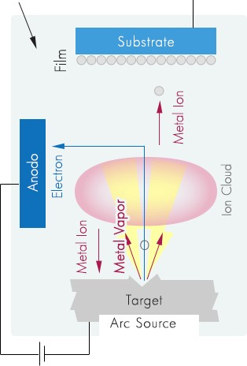
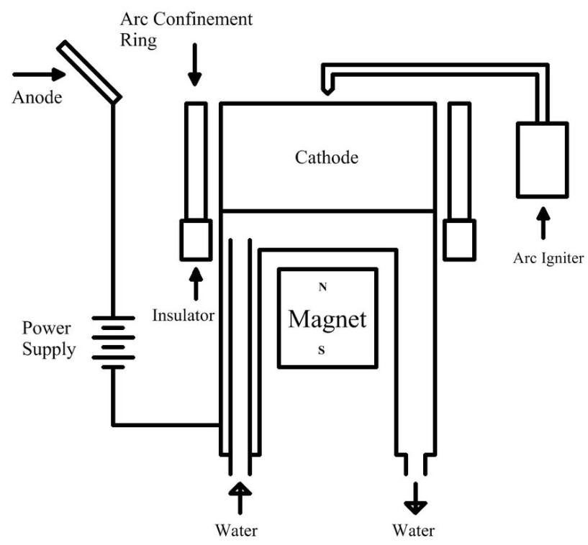
금속 이온빔 공정 : Arc Ion Plating(AIP) for TiAlN Deposition
N2 gas
Negative Bias
TiAlN
Anode
TiAl-

Slide 2
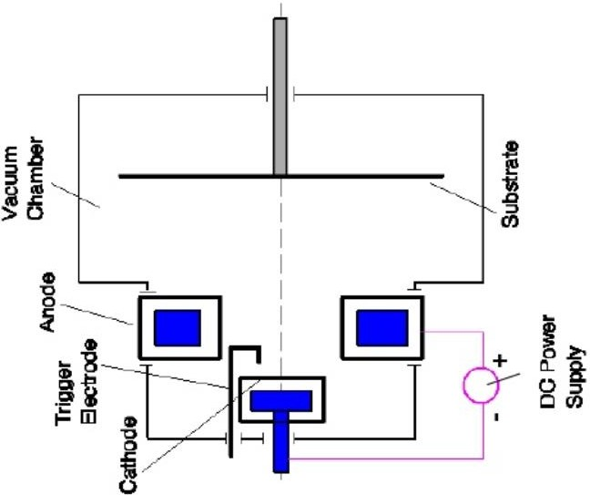
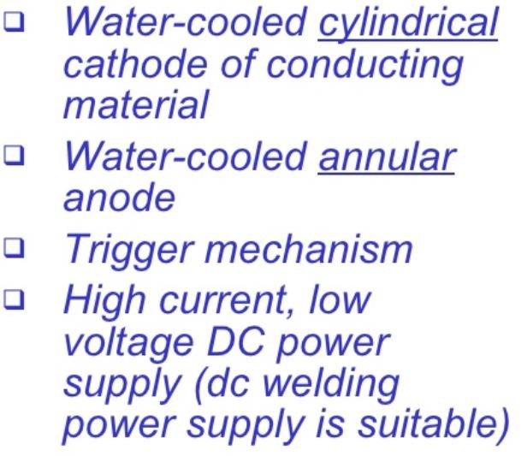
Magnetron Sputtering Vs. AIP

Slide 3
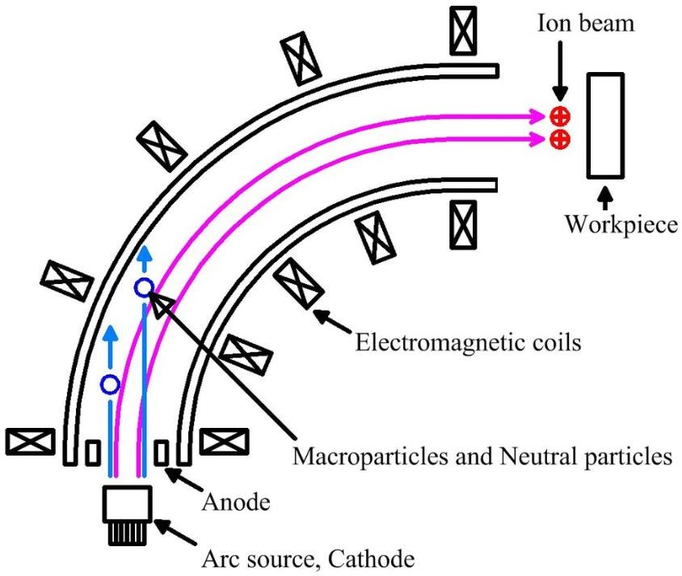
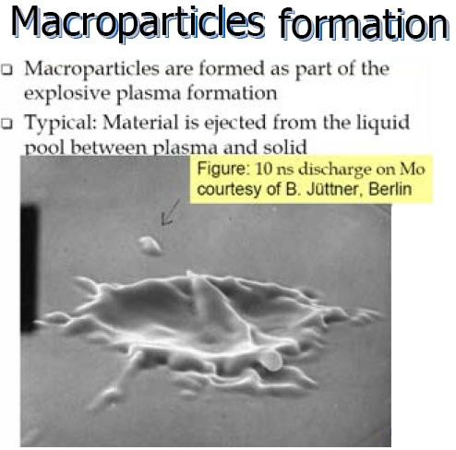

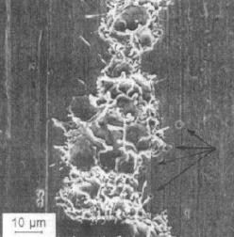

Slide 4
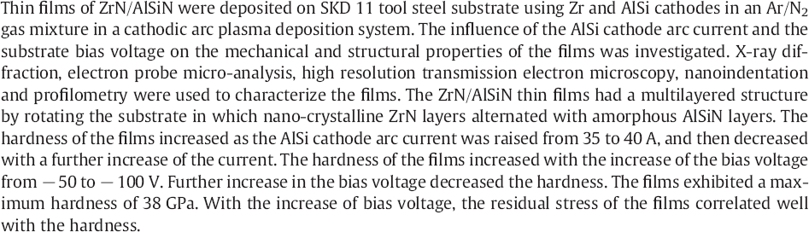
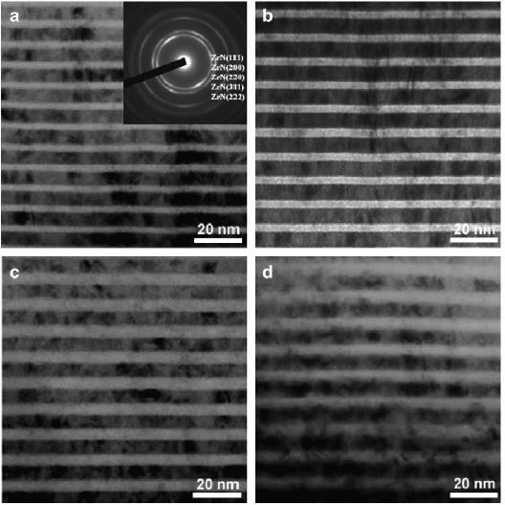
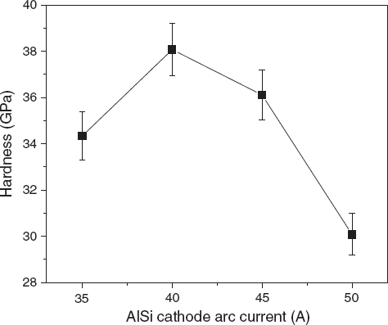

Slide 5
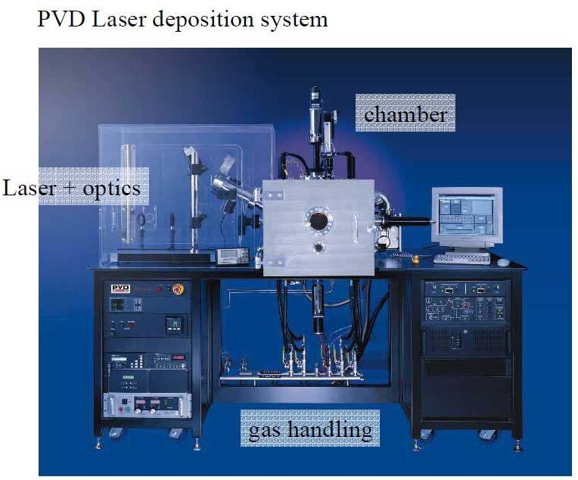
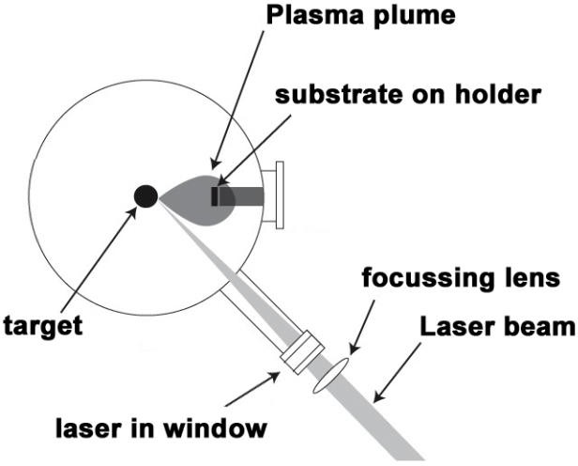
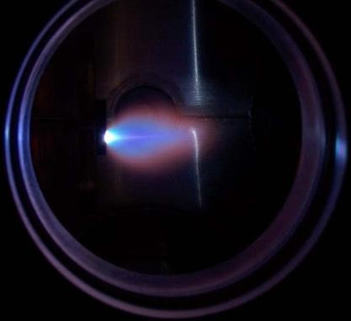
Pulsed laser deposition(PLD) :
a physical vapor deposition technique where a high power pulsed laser beam is focused to strike a target of the desired composition. Material is vaporized and deposited as a thin film on a substrate facing the target. This process can occur in ultra high vacuum or in the presence of a background gas, such as oxygen when depositing films of oxides.
A laser beam vaporizes a target surface, producing a film with the same composition as the target.
Many materials can be deposited in a wide variety of gases over a broad range of gas pressures.
One laser can serve many vacuum systems.
High quality films can be grown in 10 or 15 minutes.

